Slide 1
FHIR Terminology Tutorial
Grahame Grieve
26 March 2015
CSIRO

Slide 2
Terminology Sub-system
Code System:
Defines a set of concepts with a coherent meaning Code Display
Definition
SNOMED CT / LOINC / RxNORM
HGVS, ICPC, MIMS + 100s more
ICD-X+
ANZSCO, METEOR
A drug formulary
A config table in an application
A list of enums in a java class
Australian state codes

Slide 3
Terminology Sub-system
Code System:
Defines a set of concepts with a coherent meaning Code Display
Definition
Value Set:
A selection of a set of codes for use in a particular context
Selects

Slide 4
Terminology Sub-system
Code System:
Defines a set of concepts with a coherent meaning Code Display
Definition
Value Set:
A selection of a set of codes for use in a particular context
Element Definition: Type and Value set reference
Binds
Selects

Slide 5
Terminology Sub-system
Code System:
Defines a set of concepts with a coherent meaning Code Display
Definition
Value Set:
A selection of a set of codes for use in a particular context
Element Definition: Type and Value set reference
Binds
Selects
Conforms
Element: code/ Coding/ CodeableConcept
Refers to

Slide 6
Code System vs Value Set
Often mixed in common usage
E.g. am application table that mixes LOINC codes and custom (self defined) codes
The only way to know it’s a LOINC code is it has the distinctive NNN-N syntax
HL7 says: keep your definitions clean, or you’ll get in trouble when you exchange data
Separate the definition and use of a ‘concept’

Slide 7
Code Systems
Defines a set of concepts (or a framework)
Each concept has a meaning – a definition
Each concept has a ‘code’ to identify it (>1?)
Each concept has one or more ‘display’s – words that describe it, for some use (language, context)
Concepts may also have 0..* property (name/value) and 0..* relationship (triple)
May be able to build concepts using a grammar

Slide 8
Code Systems
Have a “URL” – uniquely identifies the code system everywhere
Good if this is dereferencible
Have a bunch of publishing metadata (name, version, date, publisher, IP requirements)
Have some use metadata (e.g. case sensitive)
FHIR: http://hl7-fhir.github.io/terminologies-systems.html

Slide 9
Inducting a Code system
What URI will be used to identify it?
What are valid codes? (syntax, expression?)
What are valid display names?
What properties can be used to define intensional value sets?

Slide 10
Referring to a code system
Each “use of a code” (a reference into a code system) has 4 properties:
system: URL of the code system
version: stated version of the code system (optional)
code: the symbol defined for the concept (code/expression)
display: a human readable representation of the concept (optional – debugging/display)

Slide 11
Data Types
code – a simple string e.g. ‘active’. List of codes is defined in schema. Code system/display/version is known for each code (usually all the same)
Coding – the 4 properties
CodeableConcept 0..* Coding ← multiple codes, different systems 0..1 Text ← supply text instead of a code

Slide 12
Examples
Code: "status" : "confirmed"
Coding: { "system": "http://www.nlm.nih.gov/research/umls/rxnorm", "code": "C3214954", "display": "cashew nut allergenic extract Injectable" }
CodeableConcept: { "coding": [{ "system": "http://snomed.info/sct", "code": "39579001", "display": "Anaphylactic reaction“ }], "text" : "Anaphylaxis" }

Slide 13
Binding
Elements have associated ElementDefinition
All elements assigned one in the specification
Context of use can supply a more specific one
ElementDefinition can have a “binding”: “This element can use the following codes”
Must have a binding for code / Coding / CodeableConcept
May have a binding for Quantity / string / uri

Slide 14
Binding Properties
name: useful human tag (used in rendering)
strength: how tight the binding is (next slide)
description: General text (optional)
valueSetReference: literal reference to a value set that defines the codes
valueSetUri: literal reference to implied value set, or literal or logical reference to a valueSet.uri (later)

Slide 15
Binding Strength
Code | Display | Definition
required | Required | To be conformant, instances of this element SHALL include a code from the specified value set.
extensible | Extensible | To be conformant, instances of this element SHALL include a code from the specified value set if any of the codes within the value set can apply to the concept being communicated. If the valueset does not cover the concept (based on human review), alternate codings (or, data type allowing, text) may be included instead.
preferred | Preferred | Instances are encouraged to draw from the specified codes for interoperability purposes but are not required to do so to be considered conformant.
example | Example | Instances are not expected or even encouraged to draw from the specified value set. The value set merely provides examples of the types of concepts intended to be included.

Slide 16
Binding Strength
Required – type = code, all the possible values in the schema (workflow, not clinical codes)
Extensible – use case is not closed, but use is closed
Preferred – note to implementation guide writers
Example – do whatever you want

Slide 17
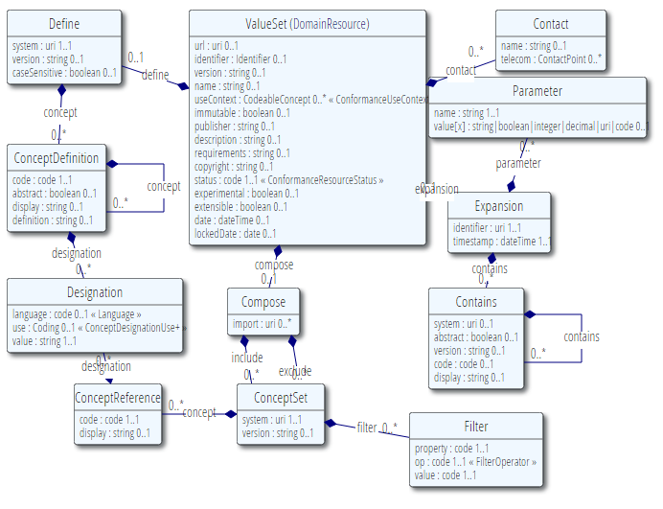
ValueSet

Slide 18
Value Set Resource
3 parts to a value set:
Metadata – identity, version, publisher, description
Content – rules for what codes are in the value set
Expansion – the result of applying the rules to the value set

Slide 19
Value Set Metadata (1)
url – authoritative url (dereferenceable preferred)
Identifier – external identifier (for elsewhere)
Version – stated version by author
useContext – where this is intended to be used
Immutable – whether changes are expected
Status – draft | active | retired
Experimental – if not intended for production
Extensible – whether intended to be extensible
Date – date published
LockedDate – when to evaluate this one (subsystem versions)

Slide 20
ValueSet Metadata (2)
Name – descriptive name
Publisher – who takes responsibility
Contacts – who to talk to with issues
Description – text, what’s in the valueset
Requirements – why this was defined
Copyright – IP notes about content (set or contents)

Slide 21
Content Logical Definition
3 ways to include codes:
In-line code system
Include other value sets
Include/exclude codes from a code system

Slide 22
#1 In-line code system
Meant for simple small code systems
Crop up all over the place
Need a really easy way to handle them
Not intended for big /broad systems (LOINC, SNOMED CT etc)
They all have their own distributions, tailored to their requirements
Functionality is pretty simple
ValueSet automatically includes all the code system
Every code-system has it’s own value set

Slide 23
In-line Code System
system: the URI the system is known by (in Coding.system)
Version: for releases of the code system (Coding.version)
caseSensitive – whether code comparison is case sensitive

Slide 24
In-line Code System
Code systems are hierarchical (is-a/subsumption)
code: goes in Coding.code
display : goes in Coding.display
definition: for code system users
abstract: whether the code can be used in a data instance

Slide 25
In-line Code System
Can have additional designations
Primary purpose is language translations, but can specify other uses too
Not meant for mapping (get to mappings later)

Slide 26
Example
"define": {
"system": "http://hl7.org/fhir/alert-status",
"caseSensitive": true,
"concept": [
{
"code": "active",
"display": "Active",
"definition": "A current alert that should be displayed to a user. A system may use the category to determine which roles should view the alert."
}, ...
]
}

Slide 27
Shareable Valueset
A lot of the metadata is optional
Code definitions are optional
Reflect minimum operational requirements, not best practice
HL7 defines a profile called ‘Shareable Valueset’ – enforces best practice
HL7 specification and registry will require conformance to this profile

Slide 28
#2 Including codes from elsewhere
You can:
Import the contents of other value sets (union of the content)
Include a set of codes from a code system
List them exhaustively
Include them by code system based criteria
Exclude a set of codes from a code system

Slide 29
Includes (1)
system/version – identify the code system
concept – a list of codes with optional displays (e.g. inline interface terminology)
can also add translations

Slide 30
Includes (1)
Filter – 1 or more expressions (‘and’)
property : name defined by code system
op: common operations
value: depends on code system property

Slide 31
Example Filters
System | Property | Op | Value
SNOMED CT | concept | is-a | [code]
RxNorm | TTY (term type) | = / in | e.g. Ingredient
LOINC | SCALE_TYP | = | DOC
V3 Act Code | concept | Is-a | Abstract code
Internal | concept | Is-a | ValueSet.define.concept.code
ISO 3166 | code | regex | [a-z]{2}

Slide 32
Versions
A valueset that doesn’t use ValueSet.compose.include.version has unknown content
Even if it lists codes explicitly
Until you decide on a version
Decision is delegated to run time
Very common thing to do

Slide 33
Expansions
There’s lots of power & complexity in the content rules
It’s intended for specialist software
Most software ‘just wants to get the list of actual codes’
That’s the ‘expansion’ of the value set – the outcome of applying the rules against actual code system versions

Slide 34
Expansions
identifier + timestamp (auditing/caching)
parameters – rules for this expansion
a list of system/version/ code/display
Can have non-selectable entries
Can have a structure (e.g. UI)

Slide 35
Getting an Expansion
Value set lives at [base]/ValueSet/[id] GET [base]/ValueSet/[id] – get the definition
A terminology server can respond to this: GET [base]/ValueSet/[id]/$expand and return the value set with expansion

Slide 36
$expand
Parameters:
date : expand as of this date
filter : only include matching concepts (text filter for UI use)
profile: a set of rules that further constrain the expansion (not specified yet)
Outcome:
Either a value set with the expansion
Or an http error with details: “too costly to expand” a common error

Slide 37
Persisting expansions
You can store an expanded valueset
Need to do this for auditing purposes (sometimes)
Might do this for reuse (caching/independence)
But system caching expansion has to know when it becomes stale
Easier just to get the expansion every time
Get terminology server to do the work

Slide 38
Expansion too big
At least some value sets are just too big to expand
>10,000 codes
Infinite in size – cannot be expanded (grammar)
Can still use these value sets:
Provide a text filter (e.g. UI lookup)
Ask the server to validate a code

Slide 39
$validate Operation
Parameters
code/system/version/display
value set identity (logical or literal)
date : the date of the validation
abstract : whether abstract codes allowed or not
Response
result : true | false valid or not
message : detailed error message (or hint)
display : the right display for the code (convenience)

Slide 40
Subsumption / membership
Subsumption and membership tests are value set validation operations: “is code X in the value set of codes subsumed by Y?”
Define common implicit value sets to make this easy e.g. GET [base]/ValueSet/$validate?code= 40370006&system=http://snomed.info/sct&identifier=http://snomed.info/sct?fhir_vs=isa/365860008

Slide 41
Concept Map Summary
Map from one set of concepts to another
Concepts = elements in a model
Concepts = codes in a value set
Maps from source to target
Mapping is uni-directional
equal | equivalent | wider | subsumes | narrower | specialises | inexact | unmatched | disjoint
Can be multi-part

Slide 42
Concept Map Example
Source (Fhir Address Use) | Equivalence | Target (v3 address use) | Comments
home | equivalent | H
work | equivalent | WP
temp | equivalent | TMP
old | disjoint | BAD | In the V3 AD, old is handled by the useablePeriod element, but you have to provide a time, there's no simple equivalent of flagging an address as old

Slide 43
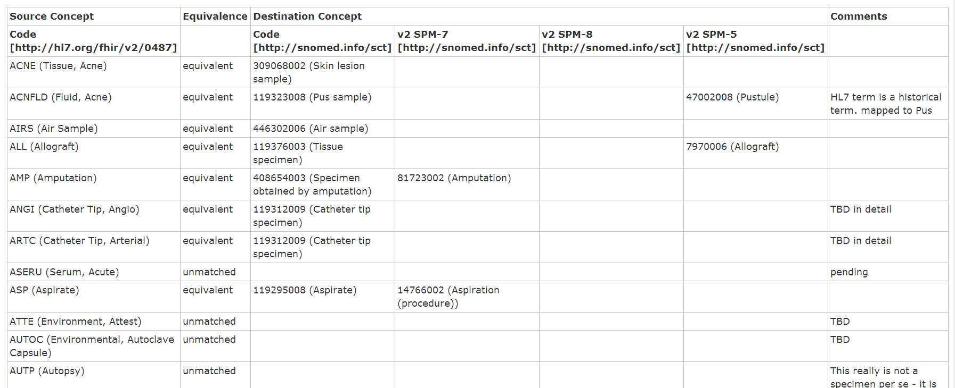
Concept Map Example
http://hl7.org/fhir/conceptmap-example-specimen-type.html

Slide 44
Concept Map Operations
Translate code
In: code / system [/version] + value set (optional)
Out: code / system + errors, hints, warnings
Are codes related?
In: (code / system [/version]) 2 + value set (opt)
Out: errors, hints, warnings

Slide 45
FHIR Terminology Server
Authoring:
ValueSet / ConceptMap
Standard FHIR repository
Services:
Expand a value set - for UI look up / code gen
Is a coding valid? – for validation
Subsumption / meaning testing
Translation

Slide 46
Leveraging Value Sets
FHIR Project provides:
Renderer – shows a value set/conceptmap to a human
Value Set Expansion (code & server)
Including with text filtering for UI support
Conformance Testing (code & server)
Full blown terminology server (open source)
Full featured repository (Private or public)
All with full mapping support

